Slide 1
Let learners lead
Lesson's from Microsoft's Social Learning Frontier
sublimemedia.com

Slide 2
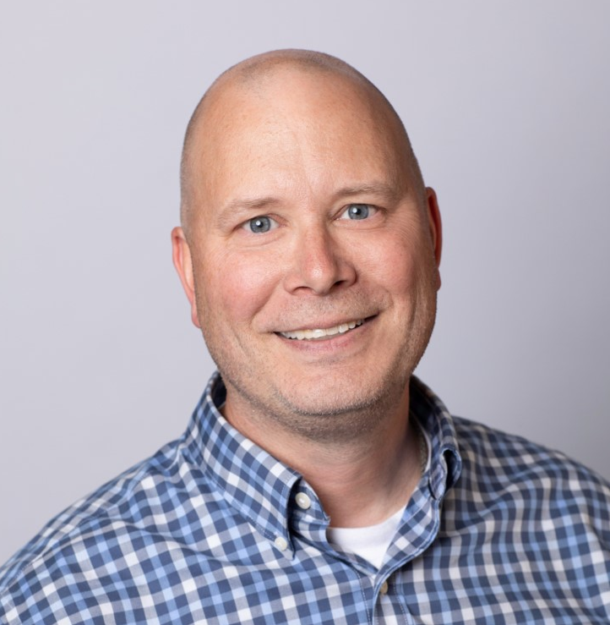
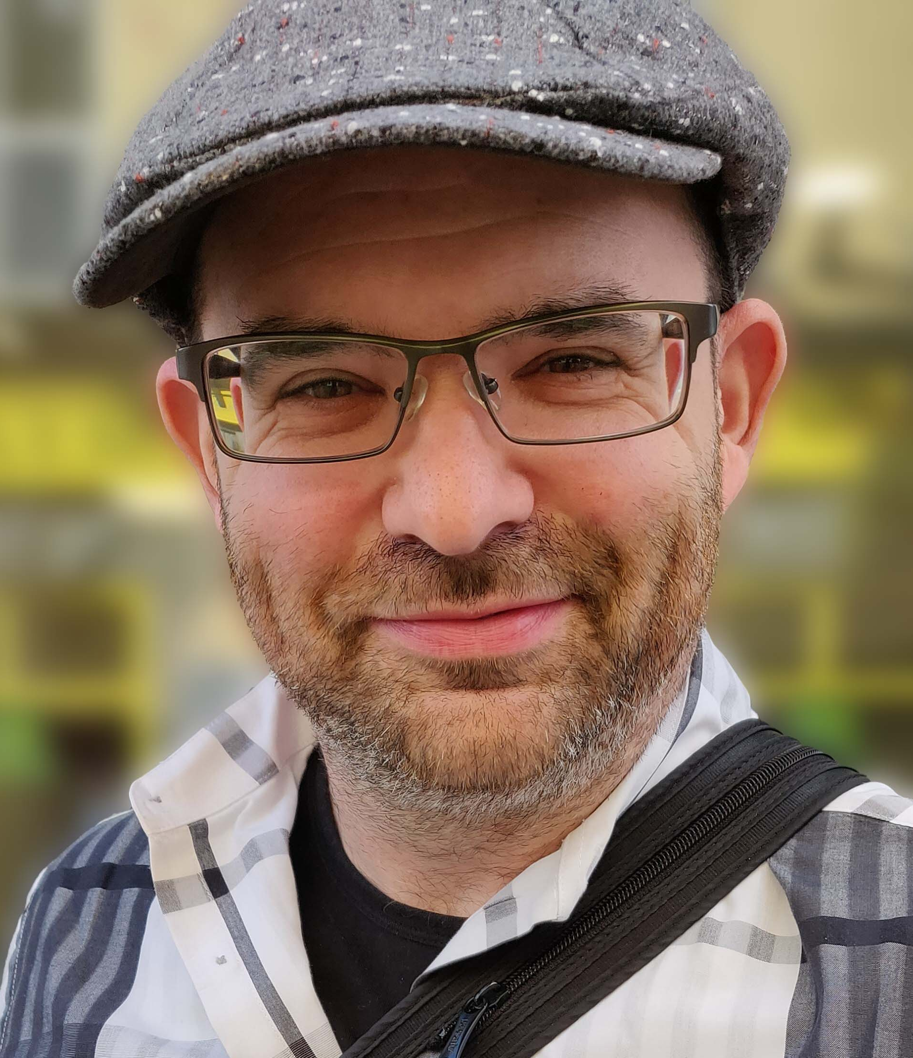
Jason Gray
Senior Learning Development Consultant
Microsoft
Global Early Career Team
David Linder
Co-founder and Creative Director
The Creative Agency for Learning
®

Slide 3
The path to personal insight leads through other people.
– David Dunning

Slide 4
Aspire Pi program objectives
For us, by us
Self-directed
No facilitator, no expert, no trainer
No learning objectives
You heard us:
no learning objectives

Slide 5
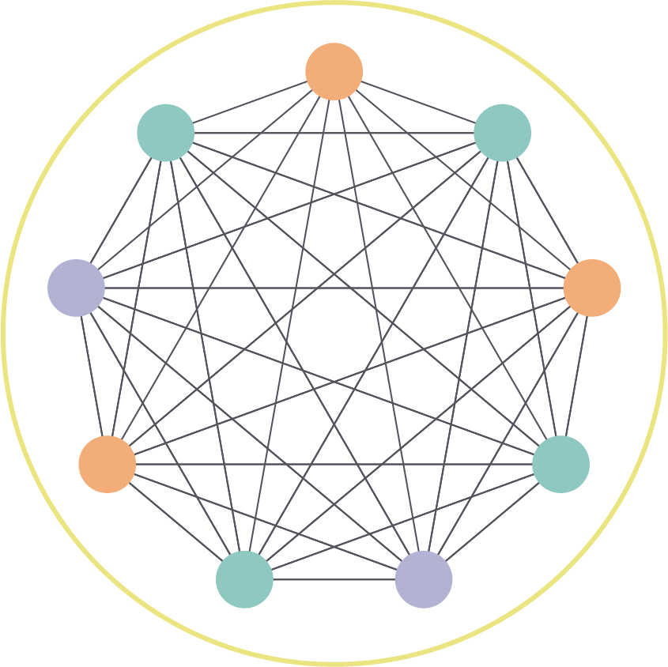
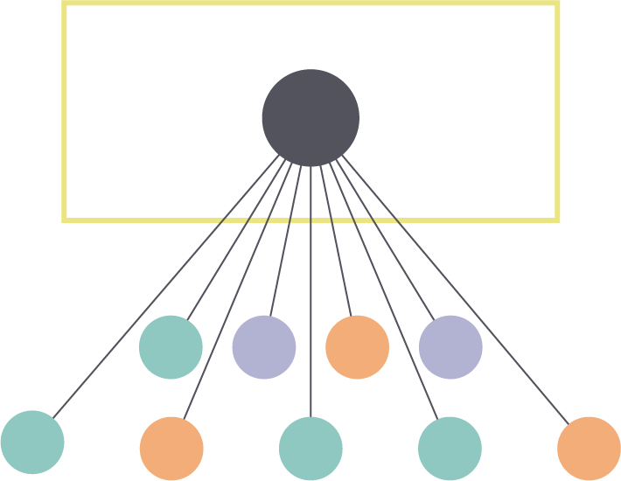
Expertise continuum
Organic
Orchestrated
Self-directed
Expert optional
Free-form conversation
Spontaneous
Structured
Instructor-led
Prescriptive conversation
Rigid

Slide 6
Expertise continuum
Organic
Orchestrated
Shadowing
Study group
Instructor-led activities
Support group
Book club
Course lab
Self-directed
Expert optional
Free-form conversation
Spontaneous
Structured
Instructor-led
Prescriptive conversation
Rigid

Slide 7
Expertise continuum
Organic
Orchestrated
1
2
3
4
5
6
7
8
9
10
Self-directed
Expert optional
Free-form conversation
Spontaneous
Structured
Instructor-led
Prescriptive conversation
Rigid

Slide 8
Expertise continuum
Organic
Orchestrated
1
2
3
4
5
6
7
8
9
10
User experience objective (UXO) driven
Learning objective driven

Slide 9
You can’t force social learning…
…but you can create an environment in which it thrives.

Slide 10
UXO 1
Everyone participates

Slide 11
UXO 2
Guide but don’t prescribe

Slide 12
Social learning is always there, embrace it.
People are craving to invest in their own learning.
Create an environment for authentic connection.

Slide 13
Thank you
The Creative Agency for Learning
®
sublimemedia.com

