Slide 1
5 Learning Trends for 2020: Re-Humanizing L&D for the Workforce of the Future
MBI – GP Strategies Company Confidential
Notes:
Data Revised 9.6.18
Information Classification
Information classification is a critical part of GP Strategies data security. The following classifications should be applied to any document that is not classified as PUBLIC INFORMATION. For more information regarding information classification and handling, please visit the IT Security Center https://gpweb.gpstrategies.com/corp/its/Security/Security-Home.aspx
High Business Impact (HBI - GP Strategies Company Confidential)
This classification category MUST be assigned to information asset types where unauthorized disclosure could cause severe or catastrophic material loss to GP Strategies, the Information Asset Owner, or relying parties. These are not actual GP Strategies classifications but some illustrative examples of what could be classified as HBI by the Information Asset Owner:
• Authentication/authorization credentials and/or other information that can be used to directly or indirectly authenticate or authorize valuable transactions
• Information under strict regulatory handling requirements (e.g., Directive 95/46/EC, GLBA, PCI, HIPAA, and CA SB1386) and/or business secrets (e.g., unannounced financials, trade secrets)
• Source code, symbols, binaries, or specifications that could negatively impact GP Strategies competitive advantage or Intellectual Property rights
Moderate Business Impact (MBI - GP Strategies Company Confidential)
This classification category MUST be assigned to information asset types where unauthorized disclosure could cause serious material loss to GP Strategies, the Information Asset Owner, or relying parties. These are not actual GP Strategies classifications but some illustrative examples of what could be classified as MBI by the Information Asset Owner:
• Unreleased training materials and network infrastructure configurations and/or designs
• Source code or binaries that, if reverse engineered or cloned, could result in serious material impact to the quality and/or integrity of GP Strategies products or brand.
Low Business Impact (LBI - GP Strategies Company Confidential)
This classification category MUST be assigned to information asset types where unauthorized disclosure could result in none to limited material loss to GP Strategies, the Information Asset Owner, or relying parties. These are not actual GP Strategies classifications but some illustrative examples of what could be classified as LBI by the Information Asset Owner:
• Companywide announcements and information that all employees, contractors, and those under NDA have been approved to read
• Source code for publicly released training materials.
Public Information:
This classification category is assigned to information intended for public use that, when used as intended, would have no adverse effect on the operations, assets, or reputation of GP Strategies, or the GP Strategies' obligations concerning information privacy. Public information requires no labeling.

Slide 2
Don Duquette
Executive Vice President
GP Strategies®

Slide 3
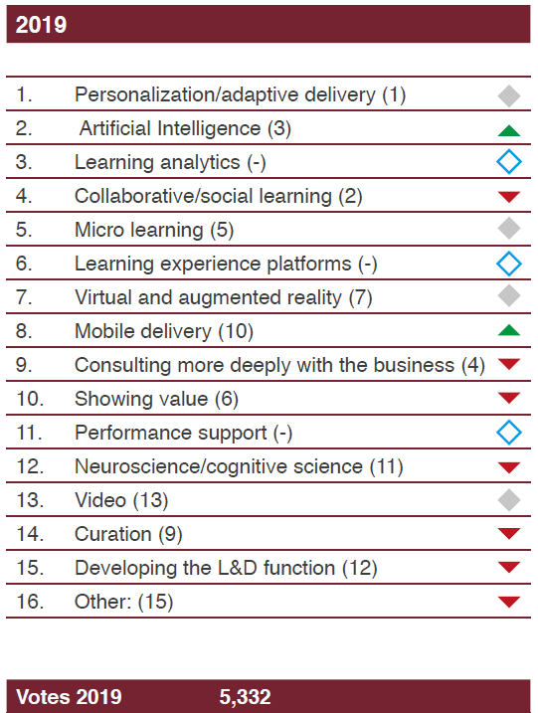
Learning and Development Global Sentiment Survey
Source: Donald H. Taylor 2019

Slide 4
TREND 1
TREND 2
TREND 3
TREND 4
TREND 5
Digital Transformation
Design Thinking
Augmented Reality
Virtual Reality
Learner Experience

Slide 5
Digital Transformation
TREND 1
Learning in the flow of work
Apps

Slide 6
Digital Transformation
Security
Augmented and
Virtual Reality
Internet
of Things
Cognitive
Systems
Robotics
3D Printing
Cloud
Big Data /
Analytics
Social
Mobility

Slide 7
OLD Approach to Learning & Work – The 3 Stage Life
Learn
Work
Retire
NEW Approach to Learning & Work – The 3 Stage Life
Learn
Work – Learn – Change – Work – Learn – Change – Work
Retire
25
50
75
100

Slide 8
21 MORE Jobs: The Road to 2029
HIGH
Mid-to-High-Tech within 5 years
Mid-to-High-Tech within 10 years
Cyber Attack Agent
Cyber Calamity Forecaster
Virtual Identity Defender
Haptic Interface Programmer
Voice UX Designer
Head Of Machine Personality Design
Flying Car Developer
Smart Home Design Manager
Machine Risk Officer
Algorithm Bias Auditor
TECH-CENTRICITY
Low-to-Mid-Tech within 5 years
Low-to-Mid-Tech within 10 years
Tidewater Architect
Subscription Management Specialist
Data Trash Engineer
Esports Arena Builder
Uni4life Coordinator
Chief Purpose Planner
Head Of Business Behavior
VR Arcade Manager
Joy Adjutant
Vertical Farm Consultant
Juvenile Cybercrime Rehabilitation Counselor
LOW
2019
TIME HORIZON
2029
Source: Cognizant 21 More Jobs Of The Future. October 2018

Slide 9
Demand for higher cognitive skills, such as
creativity, critical thinking, decision making, and complex information processing,
will grow by 19% in the U.S. through 2030.
(Source: Jacques Bughin, et al., "Skill shift: Automation and the future of the workforce," McKinsey Global Institute, 2015.)

Slide 10
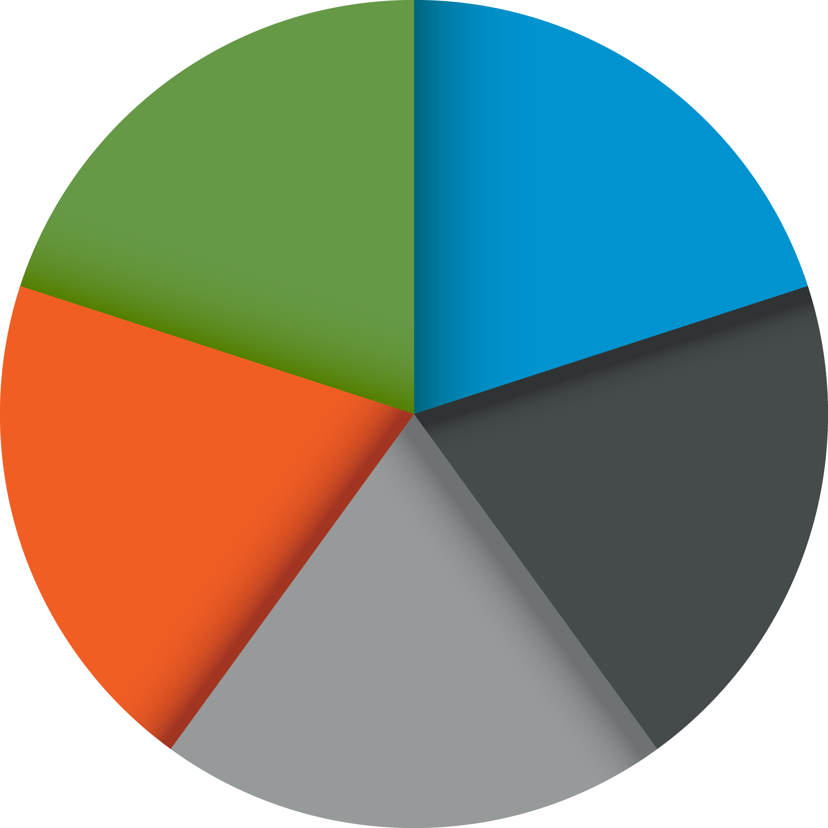
Design Thinking
1
2
EMPATHIZE
DEFINE
TREND 2
5
A process for creative problem solving
User experience
TEST
IDEATE
3
4
PROTOTYPE

Slide 11
USER EXPERIENCE
DESIGN

Slide 12
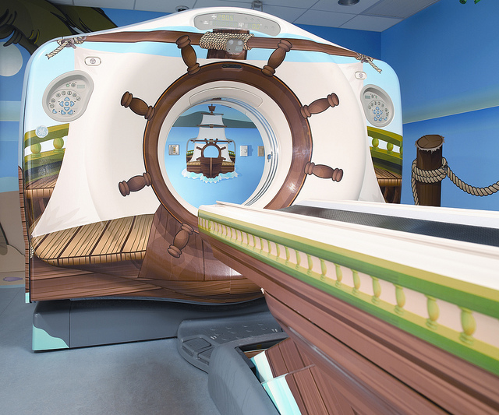
General Electric
Building a Better MR Scanner
80% Child Sedation Rate
Notes:
It looks great - cleaner, more modern. Doug was very proud of his work and started observing the usage in hospitals after installation. On one of his first observations, he followed a child patient into the scanning room and saw the child panic at the site of the machine. In that moment, he realized he had failed = failed to take into account the design of the product for all of the users. He had designed it only from his point of view and hadn’t put himself in the patient’s shoes. He then learned there was an 80% sedation rate for all children who need scans to try to calm them down. He accepted his failure and made it his mission to create a kid-friendly environment.
A year later after following the design thinking methodology, Doug redesigned machines to be kid friendly by building out unique experiences such as this….
http://newsroom.gehealthcare.com/improving-the-patient-experience-one-exam-at-a-time/
https://www.youtube.com/watch?v=jajduxPD6H4

Slide 13
General Electric
Building a Better MR Scanner
<8% Child Sedation Rate
Notes:
The pirate adventure, complete with Pina Colada air fresheners to help create that island experience. As a result, child sedation rates have dropped below 8% on his machines. Additionally, he found he helped solved for a latent need with the air fresheners – parents have shared they feel more relaxed with the smell which in turn helps the kids even further.
In the end, this was a succesful endevour for Doug. But this experience reinforced the need for Doug to think about his end users, and to Immerse, Observe and Engage with them before spending two years designing a new product. .

Slide 14
Notes:
BB

Slide 15
POLL
How often are you using design thinking to create courses?
Frequently
Occasionally
Not using

Slide 16
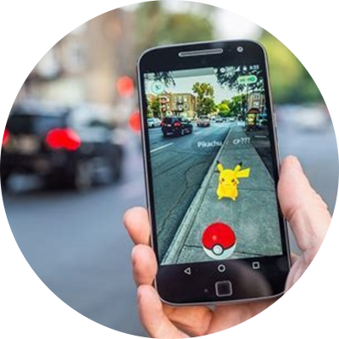
Augmented Reality
TREND 3
A real-time view that has been enhanced, or augmented, by overlaying virtual information.

Slide 17
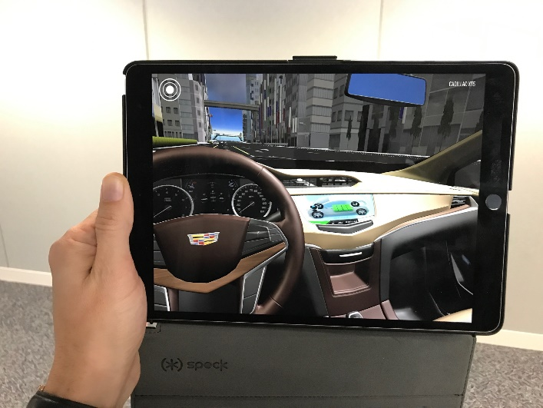
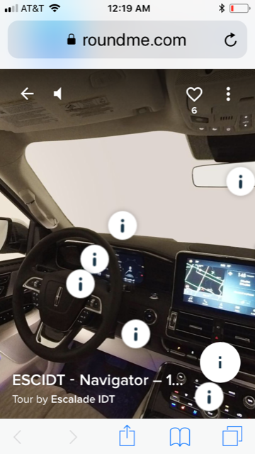

Slide 18
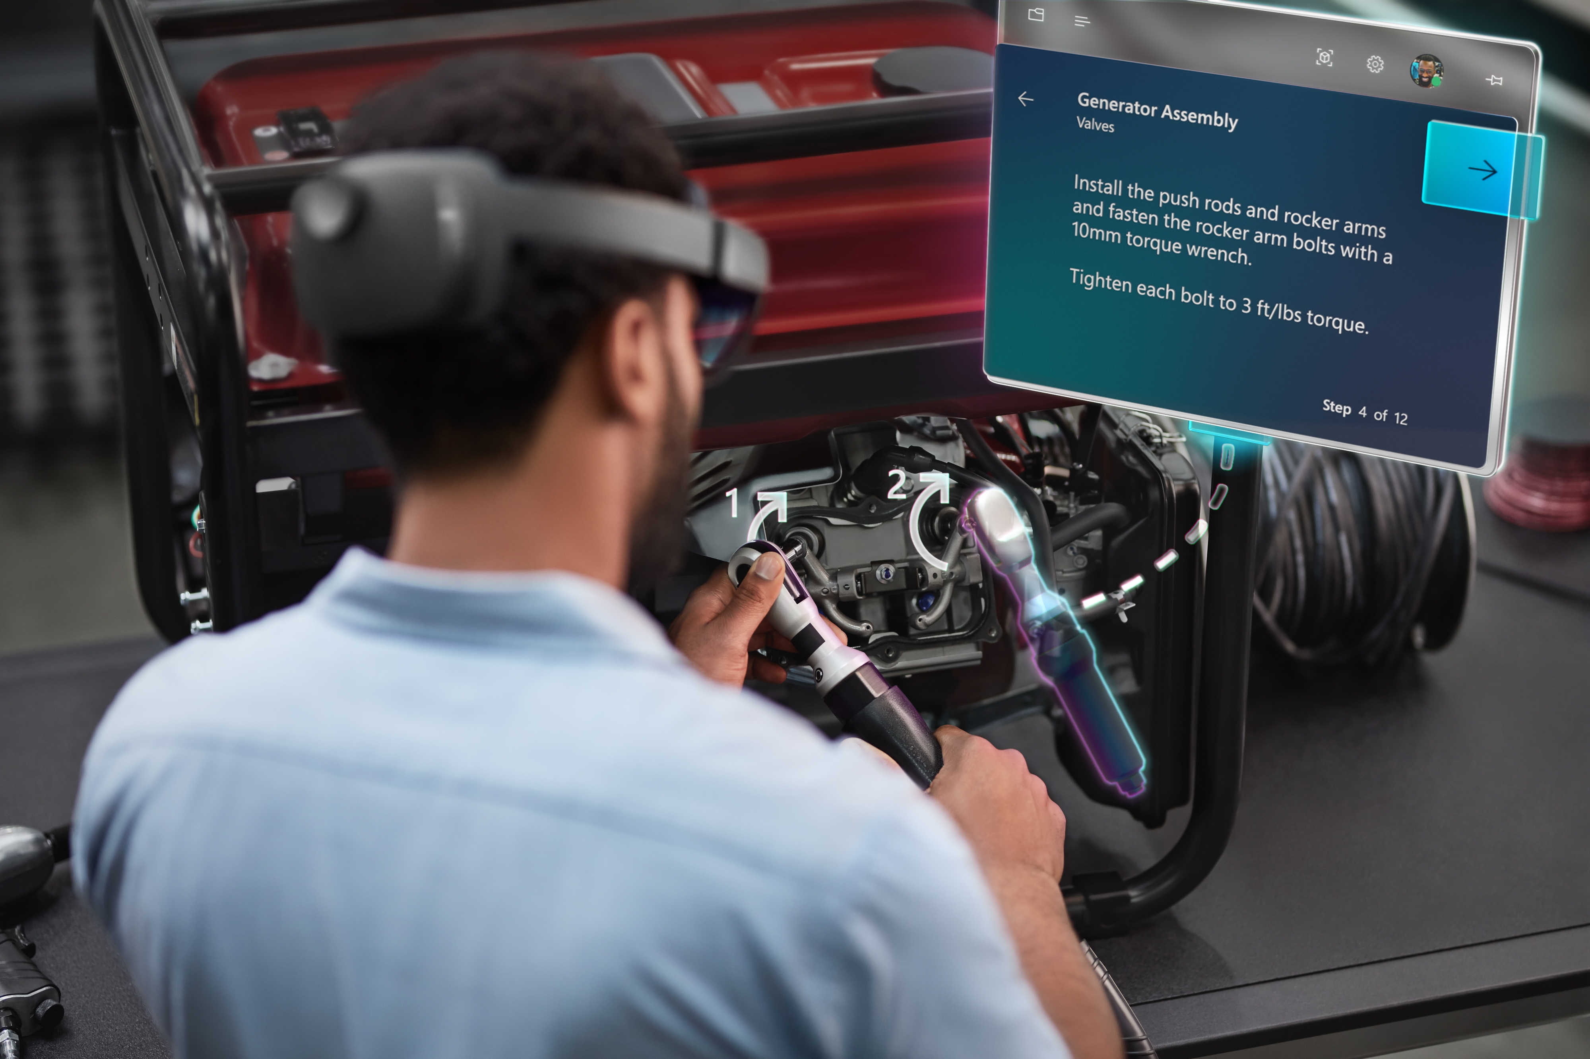

Slide 19
Virtual Reality
TREND 4
Virtual reality is the term used to describe a three-dimensional, computer generated environment which can be explored and interacted with by a person.

Slide 20
Planning
STORYBOARD
SHOT LIST
WHITEBOARD
PLANNING
SCOUTING

Slide 21
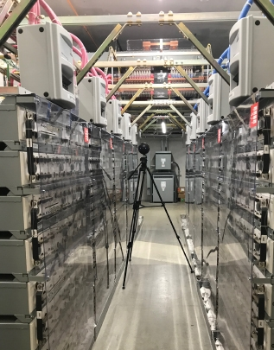
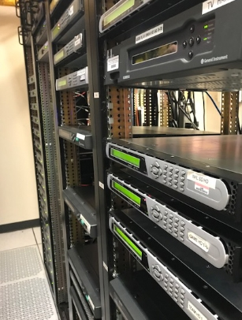
Shooting/Asset Production

Slide 22
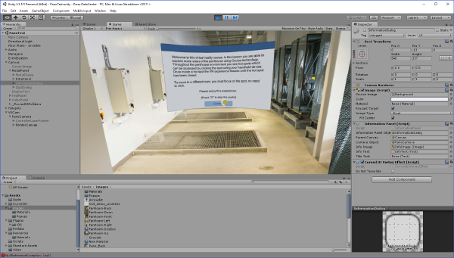
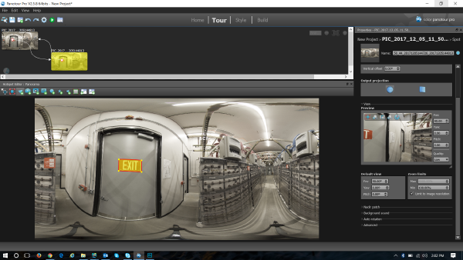
Post-Production / Development
UNITY
PANO TOUR

Slide 23
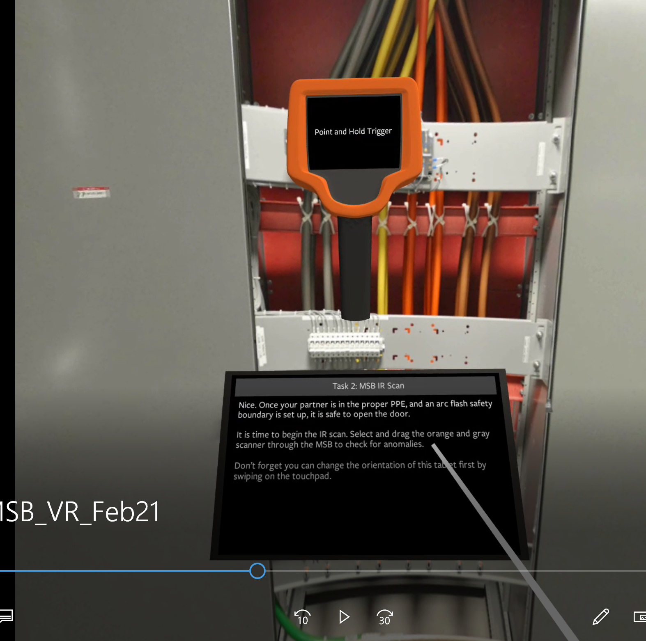
Storyboard
Scouting

Slide 24
POLL
What are you using today?
Augmented Reality
Virtual Reality
Augmented and Virtual Reality
Not using

Slide 25
Learner Experience
TREND 5
Learners are demanding more engaging courses, programs and portals
Learner experience design (LXD) has become, and will continue to be, an important element of every course, program and portal

Slide 26
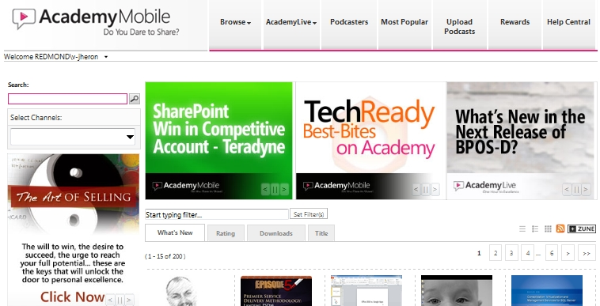
Top Navigation includes Browse, Podcasts, Podcasters, Most Popular, Uploaded Podcasts, Reward Information, Help Central, and FAQs
Search Functionality
Rotating Banners
Key Ad Placement
View by What’s New, Rating, Downloads, or Title
View Top-Rated Podcasts
Date & Number of Downloads
Tag Cloud Rotation
5

Slide 27
Adaptive Learning PLATFORM
ACCURACY
CONFIDENCE
PERSONALIZED
LEARNING
PATH
DATA
OTHER
TIME

Slide 28
Leadership Essentials Journey
Offline instructor-led sessions
Virtual instructor-led sessions
Discussion forums
On-the-job activities
Self-reflection
Peer reviews
Coaching
Project sharing
Missions
Polls
eLearning modules
Videos
Podcasts
Articles
Infographics
Job aids
iPDFs/eBooks
Online games
Quizzes
Notes:
These are the elements of that journey that, when strategically configured, create an experience that meets the needs of the organization – and the learner.
Each of these elements needs to be used based on what we want to draw out of the learner. Some are more passive while others invite learners to contribute their ideas or interact with others. And, yes, you see ILT and vILT options included because they can be important elements of a technology based journey to anchor the experience or augment the path as appropriate.

Slide 29
WEEK ONE: Virtual Kick-Off
Assignments
Program Schedule
YOUR ACTIVE ASSIGNMENTS
Set up your profile.
Send one posting about yourself and one strength.
Make a connection with two other people in your cohort.
Watch the X-model video.
Week 1: Pre-activities
Week 2: Launch Event
Week 3: MODULE 1 Manage Yourself
Week 6: MODULE 2 Work With Others
Week 10: MODULE 3 Be Future Ready
Week 12: Celebration
Transforming Performance Management
VIEW CONTENT
MY ASSIGNMENTS
VIEW CONTENT
Leaderboard
Meet Up
Technical Support
1500

Slide 31
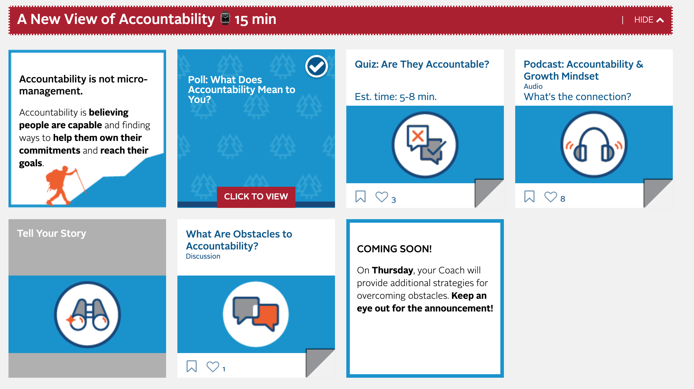
CONNECT
COLLABORATE
Notes:
Learners are asked to share what Accountability means to them
They share their own experiences with the concept of Accountability and have the opportunity to hear from others how they perceive the topic

Slide 32
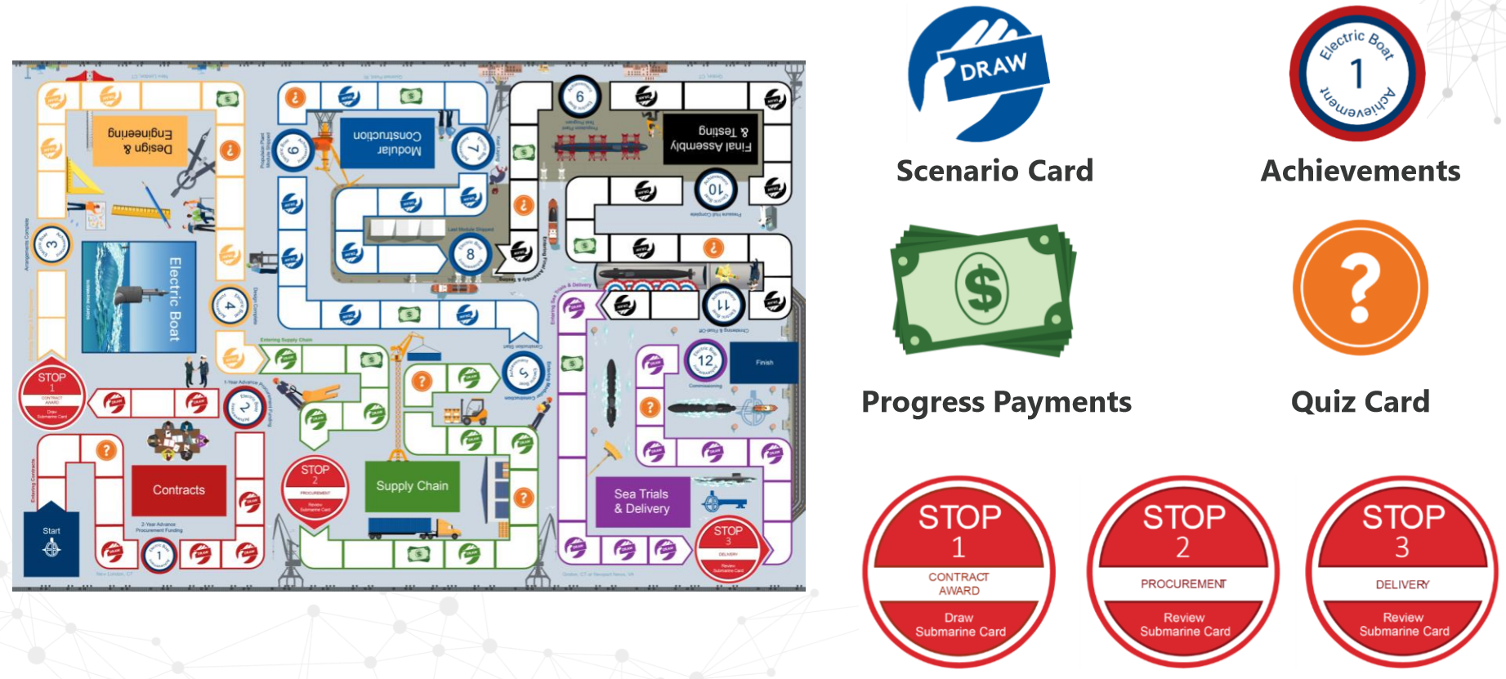
General Dynamics Electric Boat Onboarding Board Game
Notes:
Learners are asked to share what Accountability means to them
They share their own experiences with the concept of Accountability and have the opportunity to hear from others how they perceive the topic

Slide 33
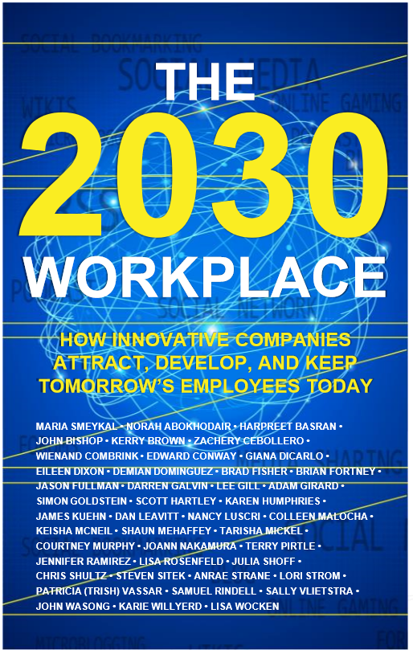
What’s next?
Pervasive and personalized augmented reality
Handheld devices are obsolete
All consumer experiences will be personalized
Embedded Intelligence
Career planning and mobility will be tied to relationships

Slide 35
Don Duquette
Executive Vice President
dduquette@gpstrategies.com
LinkedIn: linkedin.com/in/donduquette
Twitter: @dduquette

